Slide 1


Project Based learning Presentation on Auto-Craft
PVG’s COET & GKPIoM, Pune
Department of Computer Engineering
By
0025 Shravan Chandrachud
0023 Rohan Marar
0013 Kavish Gupta
0027 Sania Mulla
Under the Guidance of : Prof A. M. Bhadgale

Slide 2
Contents
Project Group
Project Motivation
Problem statement
Aim
Objective
Introduction
Requirement Gathering
Feasibility Analysis
System Requirement
Literature Survey
Existing systems
Proposed Work
Project Plan
Software Design
Software Implementation
Project Prototype
Project Demonstration
Software Maintenance
Project Outcome
Advantages/Limitations
Challenges
Project Documentation
Future Scope
Conclusions
References
Auto-Craft

Slide 3
Project Details
Title: Auto-Craft
Members:
0025 Shravan Chandrachud
0023 Rohan Marar
0013 Kavish Gupta
0027 Sania Mulla
Auto-Craft

Slide 4
Motivation
Auto-Craft

Slide 5
Problem Statement
Auto-Craft

Slide 6
Aim
Auto-Craft

Slide 7
Objectives
Auto-Craft

Slide 8
Introduction
Our project is an automated story generating model
It can generate stories in the form of text, images and videos
It can also utilize music to add more feeling into the story
Helps majorly in the entertainment industry
Can boost creativity of many people
Auto-Craft

Slide 9
Literature survey
Sr.no | Reference Name | Description | Limitations | Extra Criteria
1 | A Survey on Audio Diffusion Models: Text To Speech Synthesis and Enhancement in Generative AI | This work conducts a survey on audio diffusion model. Briefly introduces the background of audio and diffusion model and text to speech synthesis | Just a survey so the actual issues are only highlighted and not solved. | None
2 | Google Research, 2022 & beyond: Language, vision and generative models | An introductory research paper on language models, deep learning, Computer vision and other tools for AI | Not any because this one is meant to be introduction so later exposure on topics is based on your own | None
Auto-Craft

Slide 10
Existing Technologies
Text to Image generation: Midjourney
Stable Diffusion: DALL-E
Visual-GPT.
ChatGPT: For text generation
Auto-Craft

Slide 11
Existing technologies
Advantage: They all work excellently in what the are supposed to do.
Disadvantage: Not used by any major industries
How to overcome: Integrating them together to give us a multipurpose model for actual use in industries
Auto-Craft

Slide 12


Requirements
Server side: Packages and frameworks
Express - Node.js
Django, Flask – Python
Gradio
Auto-Craft

Slide 13

Requirements
Dedicated ML environment: Google Colab
Cloud server for deployment: Streamlit
Auto-Craft

Slide 14
Feasibility
All the tools required are open sourced
Technically safe and not difficult to use
LOC : 200 to 300 lines
Estimated Time: 30 to 40 days to make a working prototype and the backend. 4 months to integrate it with the frontend and make it interactive with full functionalities
Auto-Craft

Slide 15
Economical feasibility
Using Cocomo model
Auto-Craft

Slide 16
Proposed workflow
Acquiring and Integration of APIs
Taking text prompt and generating multimodal output
Rendering result onto a web application, and deploying to cloud
Processing of output files
Auto-Craft

Slide 17
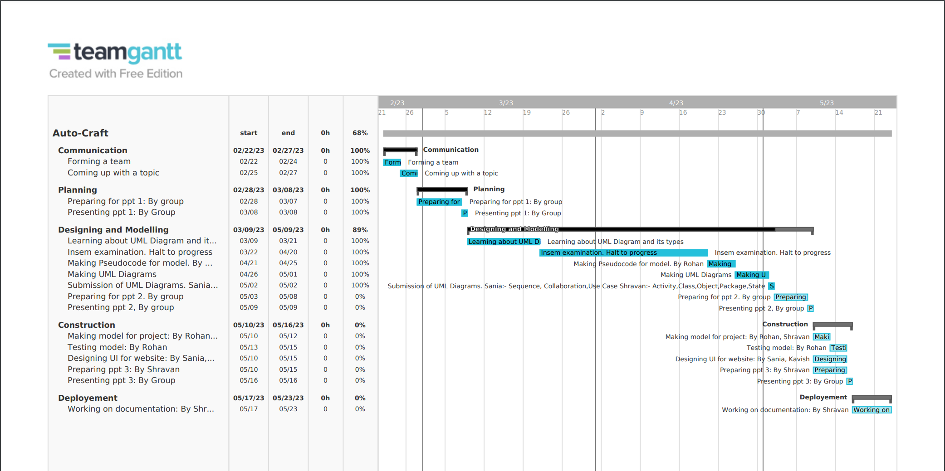
Project Plan
Auto-Craft

Slide 18
Project Plan
No. of days : 90 days for project development for prototype. Four months for integrating with frontend
Auto-Craft

Slide 19
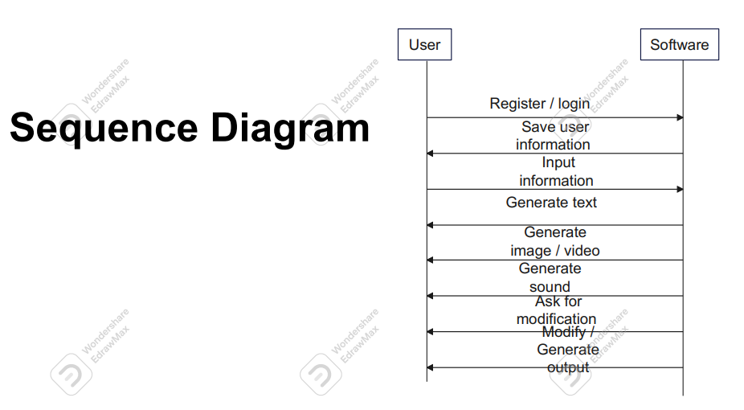
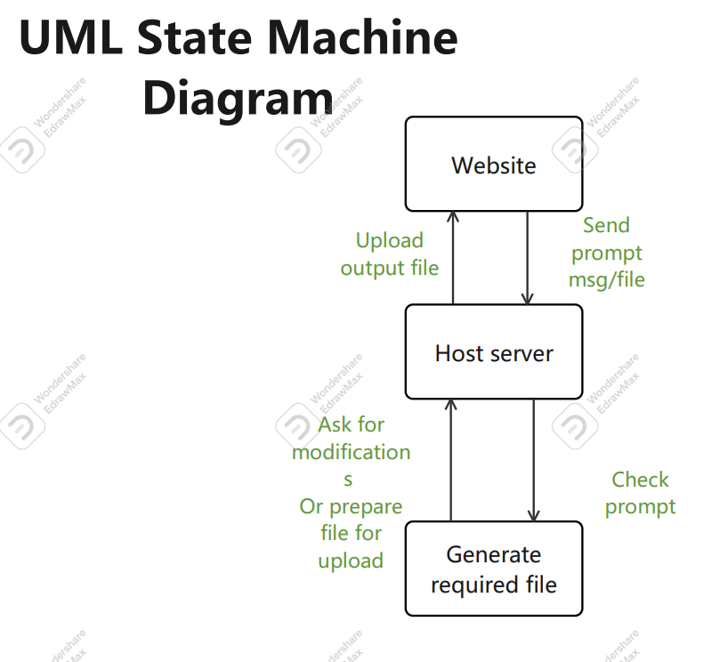
Design
Auto-Craft

Slide 20
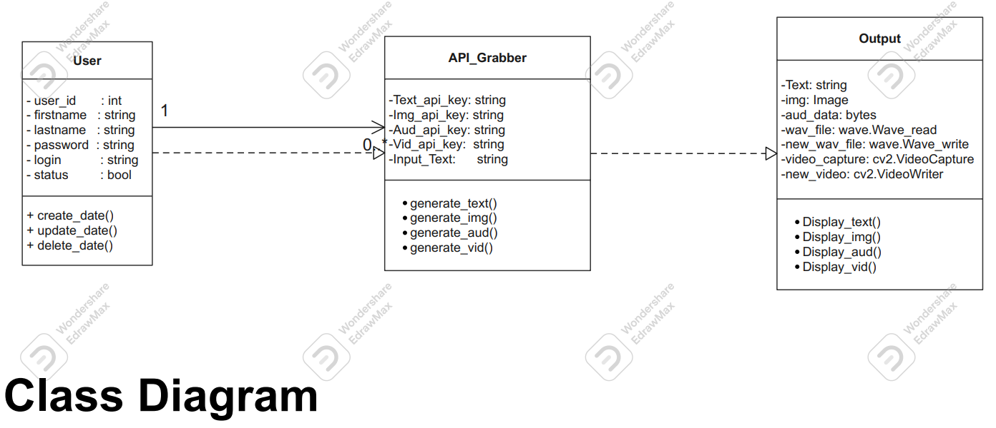
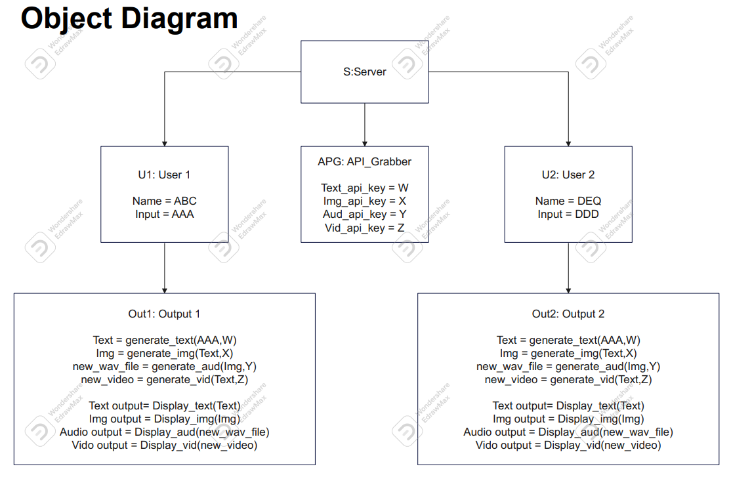
Design
Auto-Craft

Slide 21
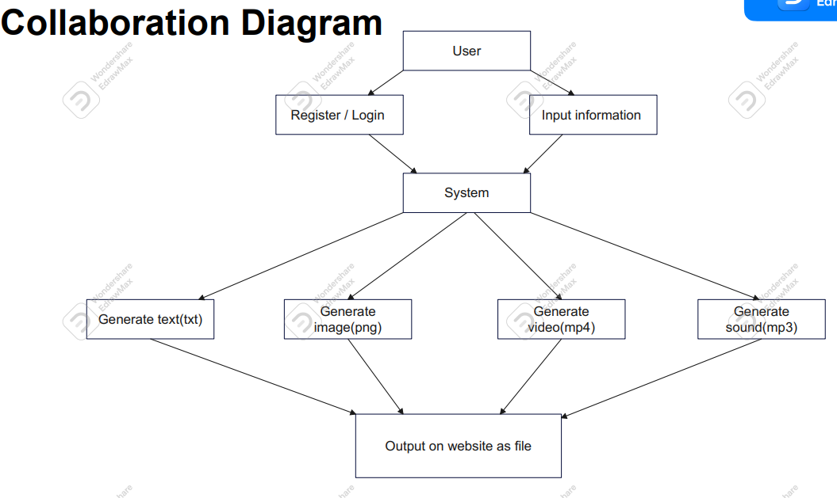
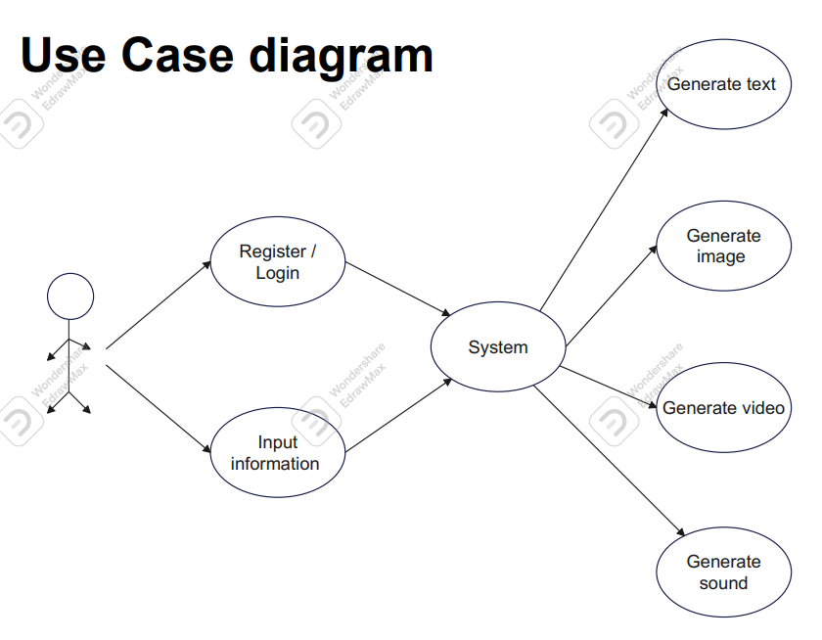
Design
Auto-Craft

Slide 22
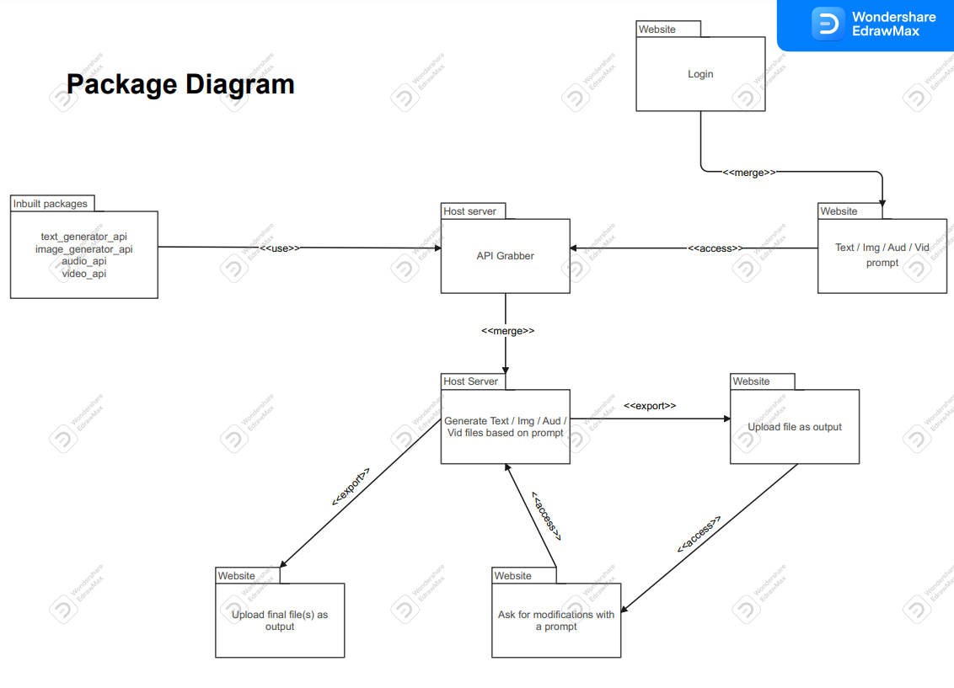
Design
Auto-Craft

Slide 23
Design
Activity Diagram :
https://drive.google.com/file/d/1ztpa1XpV6RcBmP6t1FOF9-V7_tA2x1Gu/view?usp=share_link
Auto-Craft

Slide 24
Software Implementation
Auto-Craft

Slide 25
Project Prototype
Auto-Craft

Slide 26
Project Demonstration
Auto-Craft

Slide 27
Software Maintenance
Auto-Craft

Slide 28
Outcome
Auto-Craft

Slide 29
Benefits and Limitations
Auto-Craft

Slide 30
Challenges
Auto-Craft

Slide 31
Documentation
Auto-Craft

Slide 32
Future Scope
Auto-Craft

Slide 33
Conclusion
In this PBL we studied Integration of APIs and processing of output files with the help of existing technology.
Combining efficiencies of different tools to give creative results
This study has found that people don’t use the creative tools like Chatgpt and DallE for industial use and hence we have taken the initiative to come up with it
Auto-Craft

Slide 34
References
A Survey on Audio Diffusion Models: Text To Speech Synthesis and Enhancement in Generative AI – By Chenshuang Zhang, Chaoning Zhang, Sheng Zheng, Mengchun Zhang, Maryam Qamar, Sung-Ho Bae, In So Kweon
https://arxiv.org/abs/2303.13336
Google Research, 2022 & beyond: Language, vision and generative models – By Jeff Dean on behalf of google research community
https://ai.googleblog.com/2023/01/google-research-2022-beyond-language.html
Auto-Craft

Slide 35
Thank You

